Slide 1

Implementation of Artificial Neural Network: Back Propagation Method on Face Recognition System
By: Kunal Maniyar
Roll.no:1911092
Batch:B2

Slide 2
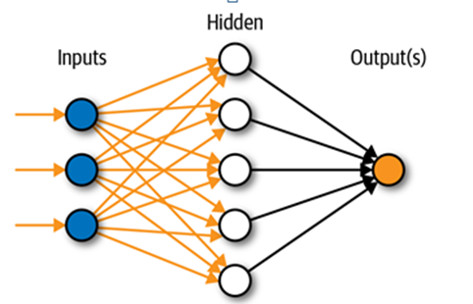
Artificial Neural Network
An artificial neural network (ANN) is the piece of a computing system designed to simulate the way the human brain analyzes and processes information.

Slide 3
General Methodology
1. Initialize parameters
2. Loop for number of iterations:
Forward propagation
Compute cost function
Backward propagation
Update parameters
3. Trained parameters are used to predict the test images

Slide 4
Initializing the parameters
weight matrix (initialized approx to 0)
Bias vector (initialized to 0)

Slide 5
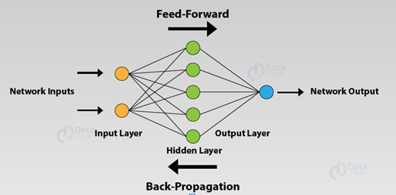
Forward Propagation
As the name suggests, the input data is fed in the forward direction through the network. Each hidden layer accepts the input data, processes it as per the activation function and passes to the successive layer.

Slide 6
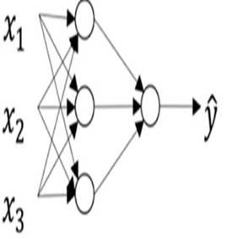
Forward Propagation
2-layer neural network
Formulae:
Z^{[1]}= W^{[1]}X+ b^{[1]}
A^{[1]}=sig(Z^{[1]})
Z^{[2]}= W^{[2]} A^{[1]} + b^{[2]}
A^{[2]}=sig(Z^{[2]})
A^{[2]} is the final probability

Slide 7
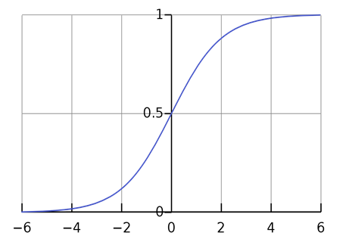
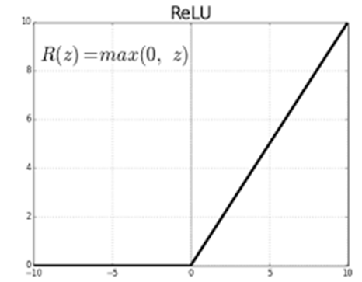
Activation Function: An activation function in a neural network defines how the weighted sum of the input is transformed into an output from a node or nodes in a layer of the network.
SIGMOID FUNCTION
RELU FUNCTION
Y=1/(1+e^{(-z)} )
Y=max(0,z)

Slide 8


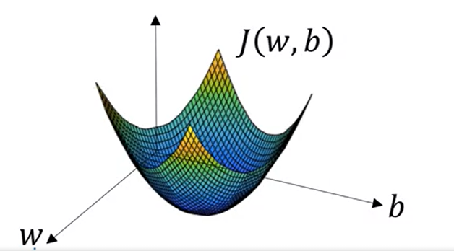
Cost Function

Slide 9
Back Propagation
Back-propagation is the essence of neural net training. It is the method of fine-tuning the weights of a neural net based on the error rate obtained in the previous epoch (i.e., iteration). Proper tuning of the weights allows you to reduce error rates and to make the model reliable by increasing its generalization.
Formulae:
dW^{[L]} = (1/m)* dZ^{[L].}A^{[L-1]T}
db^{[L]} =(1/m)*np.sum(dZ^{[L]},axis=1,keepdims=True)
dZ^{[L-1]} = W^{[L]T} dZ^{[L]}*g’^{[L-1]}(Z^{[L-1]})

Slide 10
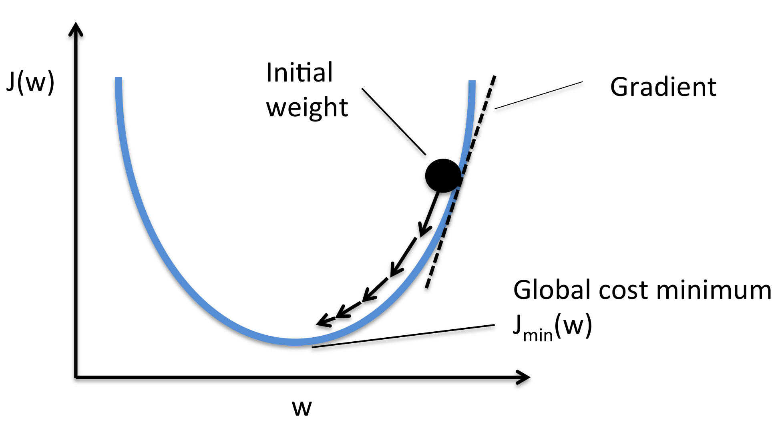
Gradient Descent
We keep on updating the parameters, so that the cost we get keep on reducing till we reach the global minimum position.
W=W-α*(dJ(w,b))/dw
b=b-α*(dJ(w,b))/db

Slide 11
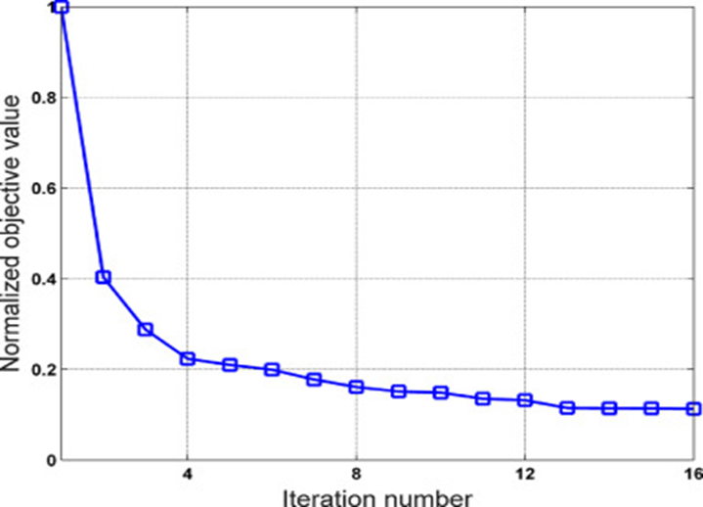
Cost vs number of iterations

Slide 12
Examination Process
The trained parameters are used to predict the test images.
For example:
Suppose the neural network is trained on the set of certain positive and negative images.
So, when the test image is given as an input ,it will recognize that the given image is positive or the negative one, based upon the output generated between 0 and 1.

Slide 13
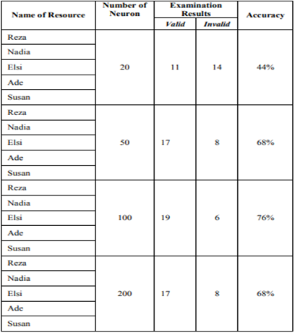
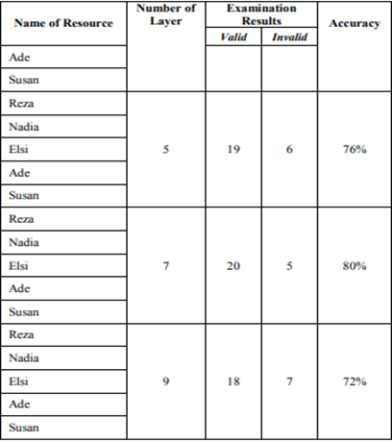
INCREASING THE ACCURACY
Variation in the number of neurons
Variation in the number of layers

Slide 14
Implementation Strategy
Taking a dataset of 50 to 100 images.
Entire implementation would be done using python3.
Libraries such as Numpy,Matplotlib and OpenCV would be used for performing different tasks
OpenCV: It is used for preprocessing the image
Numpy: It is used store the pixels of all the images in matrix form and all the calculations would be done in matrix form.
Matplotlib:It is used for plotting the graph of cost vs number of iterations.

Slide 15
CONCLUSION
By performing the backpropagation technique we would be able to detect that how many images of the required persons are present in the dataset taken. This is depicted in the form of probability.

Slide 16
Credits:
RIKI MUKHAIYAR-ISPAI Research Group, Dept. of Electrical Engineering Universitas Negeri Padang , Indonesia
REZA SAFITRI-Dept of Electrical Engineering Universitas Negeri Padang , Indonesia

Slide 17
Bibliography
S. Z. Li and A. K. Jain, Handbook of Face Recognition. New York: Springer Verlag, 2004.
https://datascience.stackexchange.com

Slide 18

THANK YOU

